Slide 1


DNA-based detection and differentiation of Blastocystis – leverage, grey zones, and pitfalls
Christen Rune Stensvold (Senior Scientist, PhD)
Reference Laboratory of Parasitology, Statens Serum Institut
Copenhagen
Denmark
Visiting Professor
Department of Protozoology
Faculty of Tropical Medicine
Mahidol University, Bangkok, Thailand

Slide 2


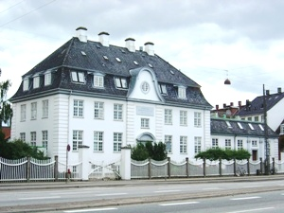
Background
Senior Scientist, BMedSc, MSc, PhD
Reference Laboratory of Parasitology, Statens Serum Institut (SSI)
Employed at the SSI since June 2004
PhD i Health Sciences from University of Copenhagen (2008)
Post doc studies at London School of Hygiene and Tropical Medicine (LSHTM) 2009–2011
Fritz Kauffmann Prize in 2013
Special interest: The role of common intestinal parasites in human health and disease
University of Copenhagen
LSHTM
SSI

Slide 3
Declarations/disclosures
No financial interests to disclose
Blastocystis is used as an example in the following, but many of the points are more or less directly applicable to other organisms.

Slide 4
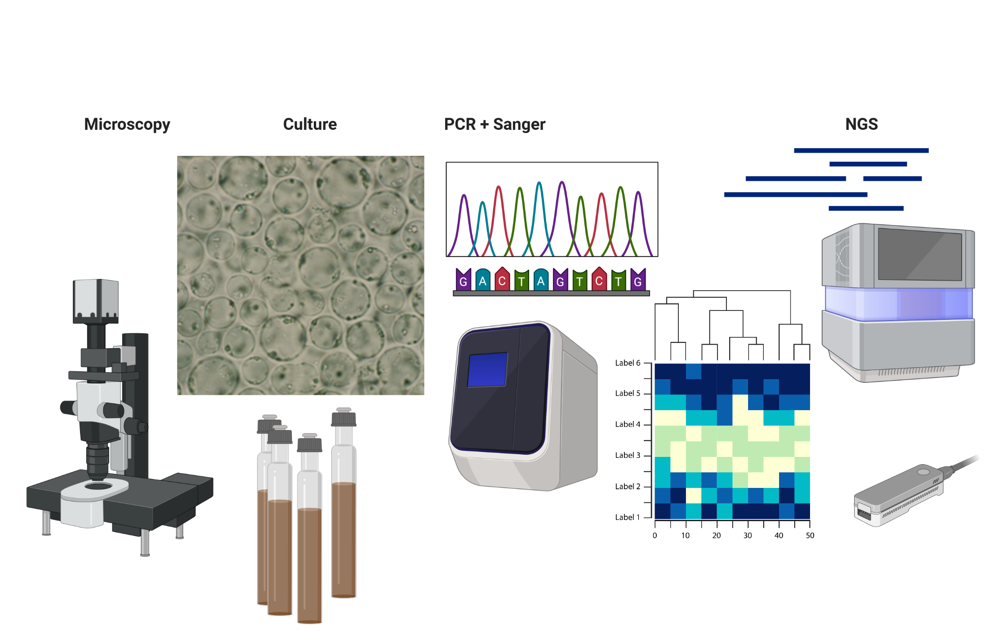
Methods in Blastocystis diagnosis, epidemiology and research
Metagenomics/metabarcoding

Slide 5
Points of address
Grey zones and pitfalls of DNA-based detection
Sequence chimeras
False-negative results
False-positive results
Defining positive/negative samples using NGS methods
Overlooking mixed infections
Misannotation of DNA sequences
Erroneous conclusions
Leverage of DNA-based detection
High throughput – automization
High sensitivity
Exhaustive molecular characterization
Transkingdom relationships – Blastocystis in a gut microbiota context

Slide 6
Points of address
Grey zones and pitfalls of DNA-based detection
Sequence chimeras
False-negative results
False-positive results
Defining positive/negative samples using NGS methods
Overlooking mixed infections
Misannotation of DNA sequences
Erroneous conclusions
Leverage of DNA-based detection
High throughput – automization
High sensitivity
Exhaustive molecular characterization
Transkingdom relationships – Blastocystis in a gut microbiota context
First, some quick facts about Blatstocystis

Slide 7
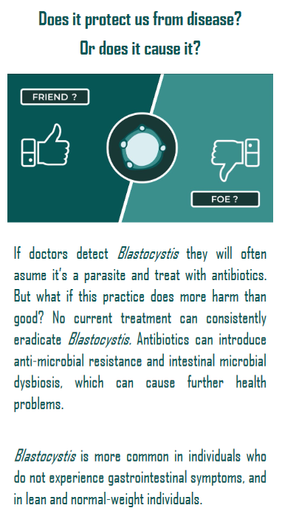
Blastocystis
Single-celled intestinal parasite
At least 1 billion people colonised
Also a typical finding in many classes of animals, but by far most common in herbivorous hosts
About 40 subtypes identified to date
The subtype system applies to Blastocystis from mammalian and avian hosts only
We don’t know how to differentiate between colonisation and infection
Although we think that it doesn’t have pathogenic properties, we refer to it as a parasite since it requires a host to complete its life cycle

Slide 8
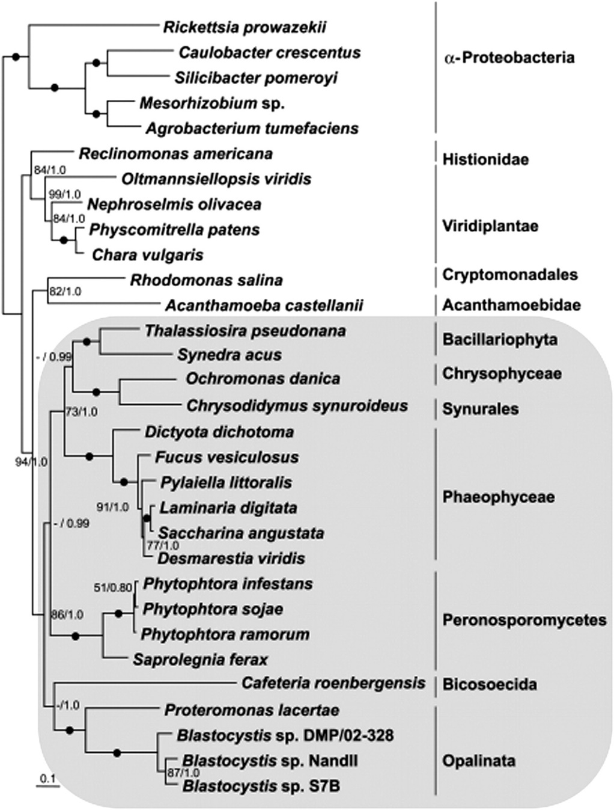
Phylogenetic position
Blastocystis is the only member of Stramenopiles known to colonise the human intestinal tract
stramenopiles

Slide 9
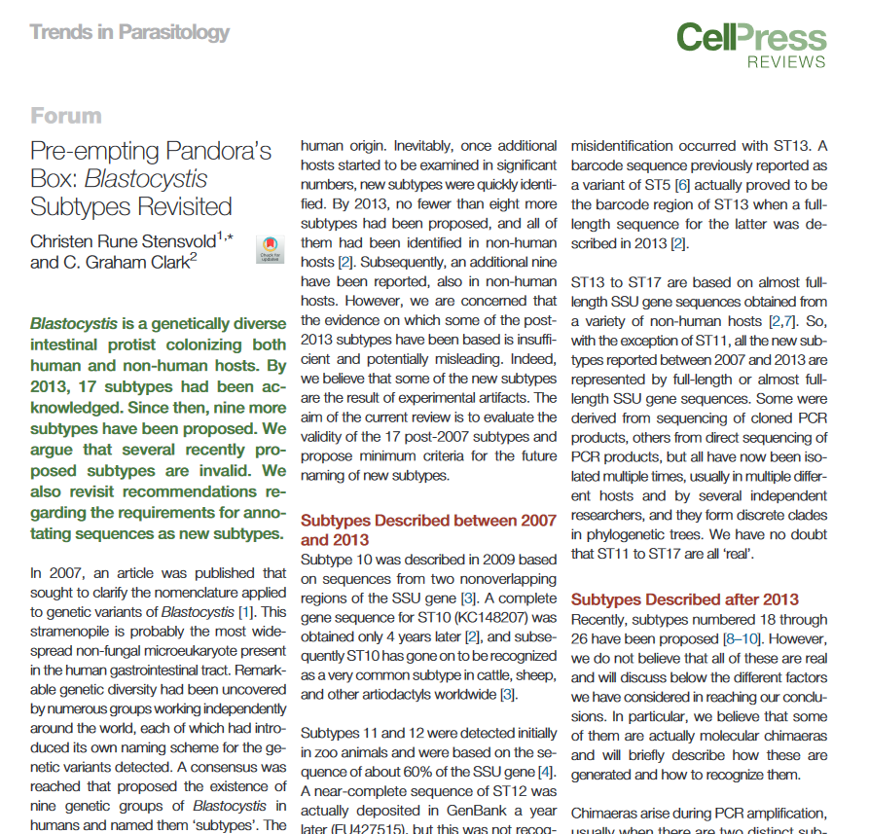
Blastocystis subtypes (ST)
ST1-ST4 = humans and non-human primates
ST5 = pigs
ST6 + ST7 + ST9 = birds
ST8 = rats?
ST10 = cattle, deer, etc.
ST11–ST17 = various mammalian hosts
ST21 = herbivorous mammals
ST23–ST46 = various animal hosts
Invalid subtypes (chimeras):
ST18 (5’- = Blasto; 3’- = unknown organism)
ST19 (5’- = ST3, 3’- = ST1)
ST20 (5’- = unknown organism, 3’- = ST5)
ST22 (5’- = ST14, 3’- = ST10)

Slide 10
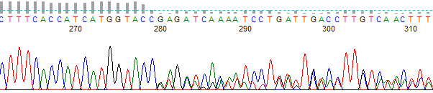
Chimeric sequences
“Chimeras are artifact sequences formed by two or more biological sequences incorrectly joined together. This often occurs during PCR reactions using mixed templates (i.e., uncultured environmental samples). Incomplete extensions during PCR allow subsequent PCR cycles to use a partially extended strand to bind to the template of a different, but similar, sequence. This partially extended strand then acts as a primer to extend and form a chimeric sequence. Once created, the chimeric sequence is then further amplified in subsequent cycles. The end result is a PCR artifact that does not represent a sequence that exists in nature.”
https://www.ncbi.nlm.nih.gov/genbank/rrnachimera/

Slide 11
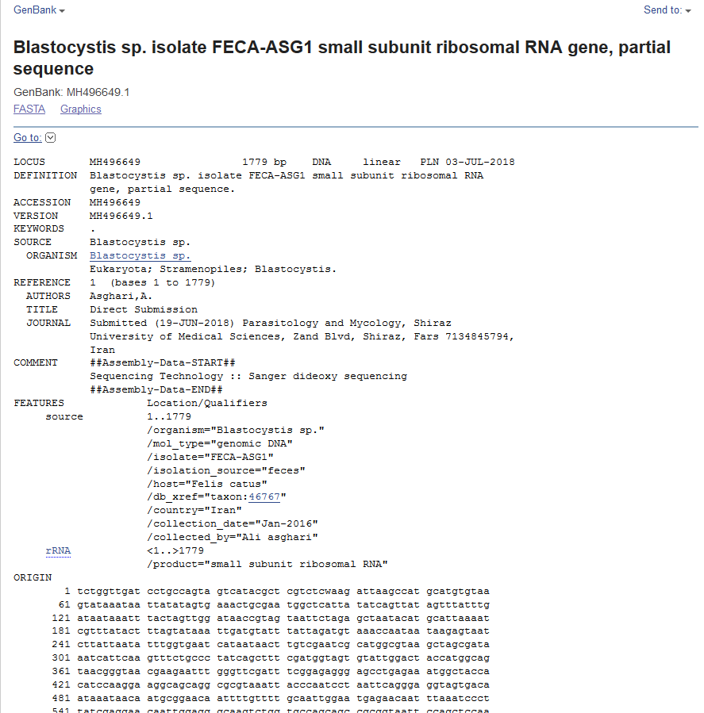

Slide 12
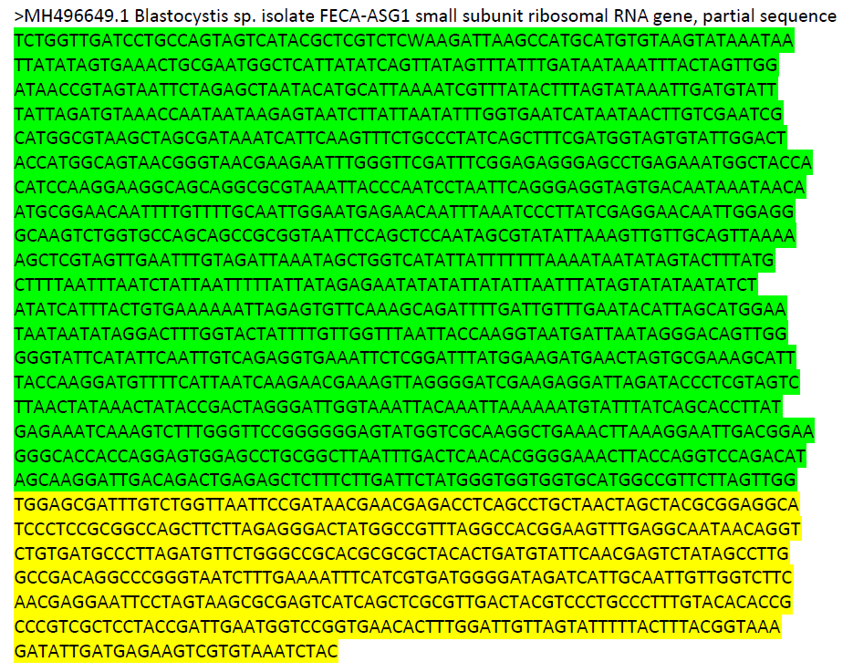

100% match to Blastocystis sequences from tortoise

Slide 13
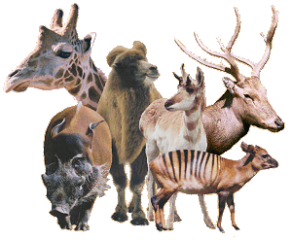





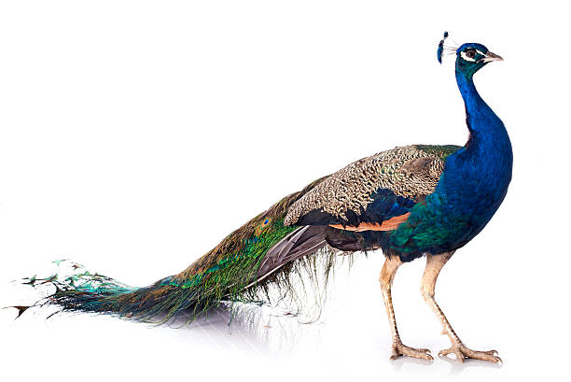
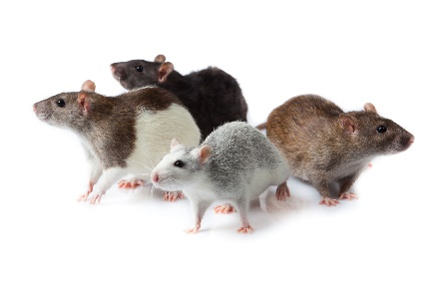




72
ST24
79
ST14 (KC148206)
65
ST14 (KC148205)
ST25
58
ST12
ST13
ST21
ST26
ST5
ST11
98
ST2
90
ST1
ST7
99
ST6
ST9
90
ST4
61
ST8
94
99
ST10
ST23
ST3
2019
ST16
ST17
ST15
Notes:
Two ST14 not clustering together. This is probably because only partial gene information is available for some of the new subtypes.

Slide 14
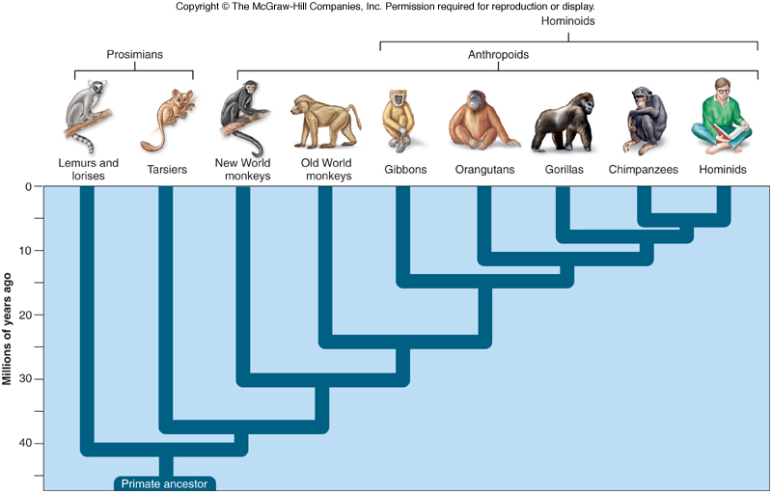
Blastocystis in non-human primates
everything
8
1
1
3
3
3
2
1
1
2
3
2
2
5
4

Slide 15
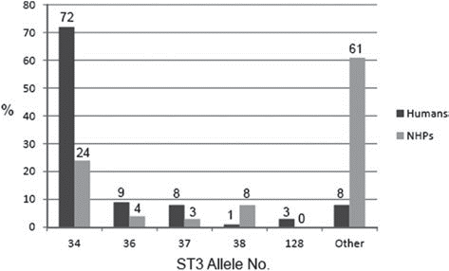
Cryptic host specificity – ST3
Alfellani et al., Parasitology. 2013 Jul;140(8):966-71

Slide 16
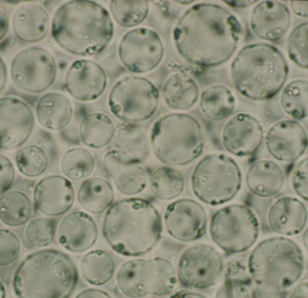

Blastocystis culture
One of very few parasites that can be cultured with little effort
(easy and inexpensive)

Slide 17
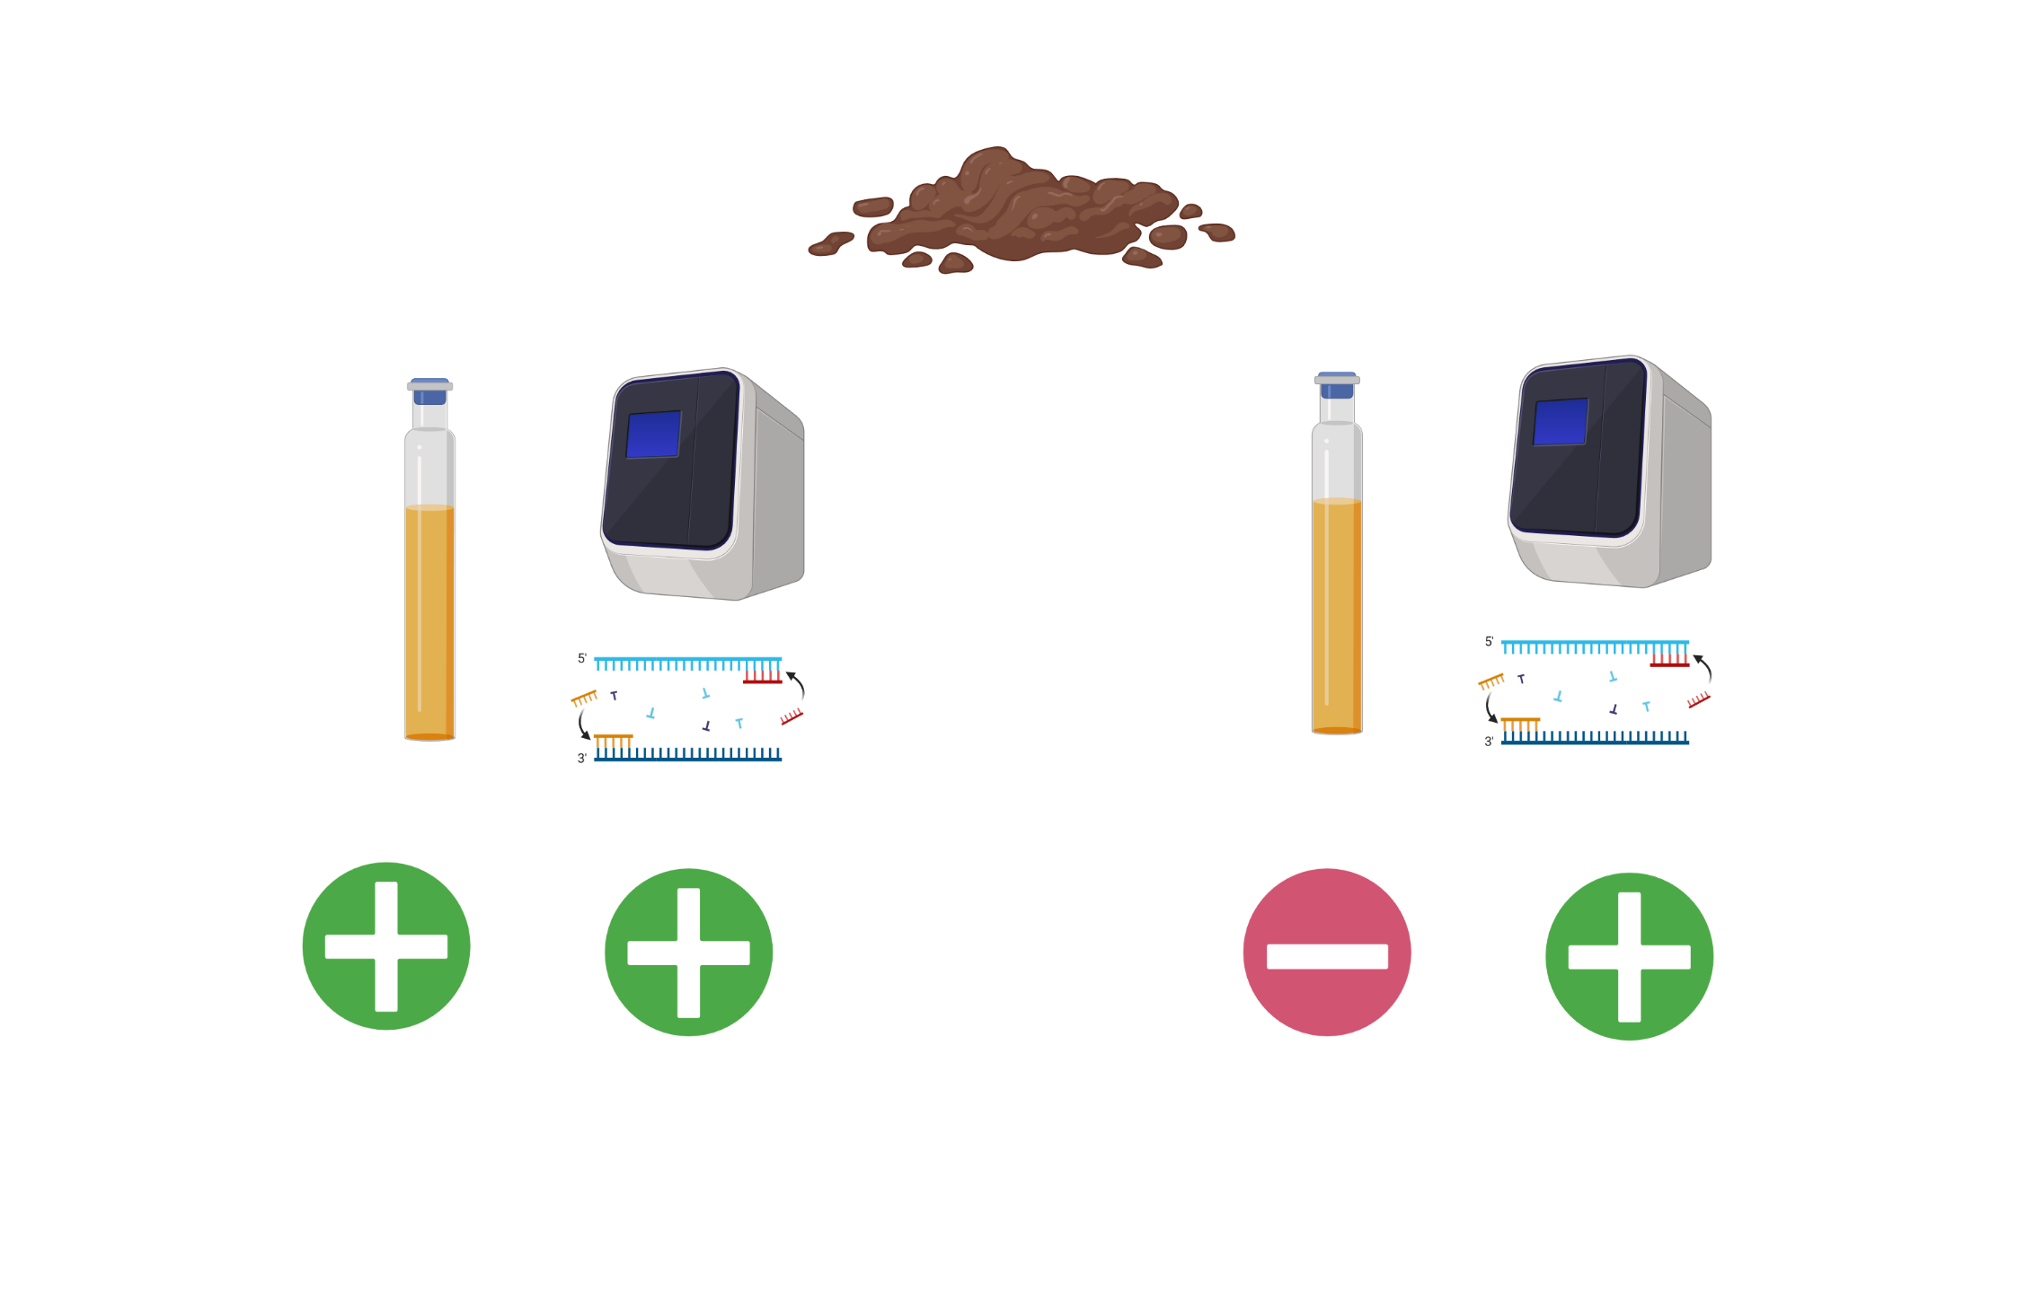
Colonization
Colonization? Contamination? Blastocystis from prey?

Slide 18
LIKELY scenario in humans
25%
The relative prevalence of Blastocystis in a given population may reflect the degree of dysbiosis?
20%
15%
10%
5%
Gut-healthy
IBS
IBD
Acute diarrhoea/Clos. Diff.
EUBIOSIS
DYSBIOSIS

Slide 19

Figure 1. Hypothesis: Blastocystis colonisation (left half of the image) and high strictly anaerobic gut microbiota diversity is characteristic of individuals with an active life style, lower BMI, and a fiber-rich diet that involves raw food, including vegetables, whereas individuals with sedentary life styles, higher BMI, and a low-fiber diet comprising mainly ultra-processed food have low-diversity, facultative anaerobic, parasite-free gut microbiota and are signficantly more prone to showing and developing cardiometabolic disease traits, including overweight and diabetes (right half of the image).

Slide 20
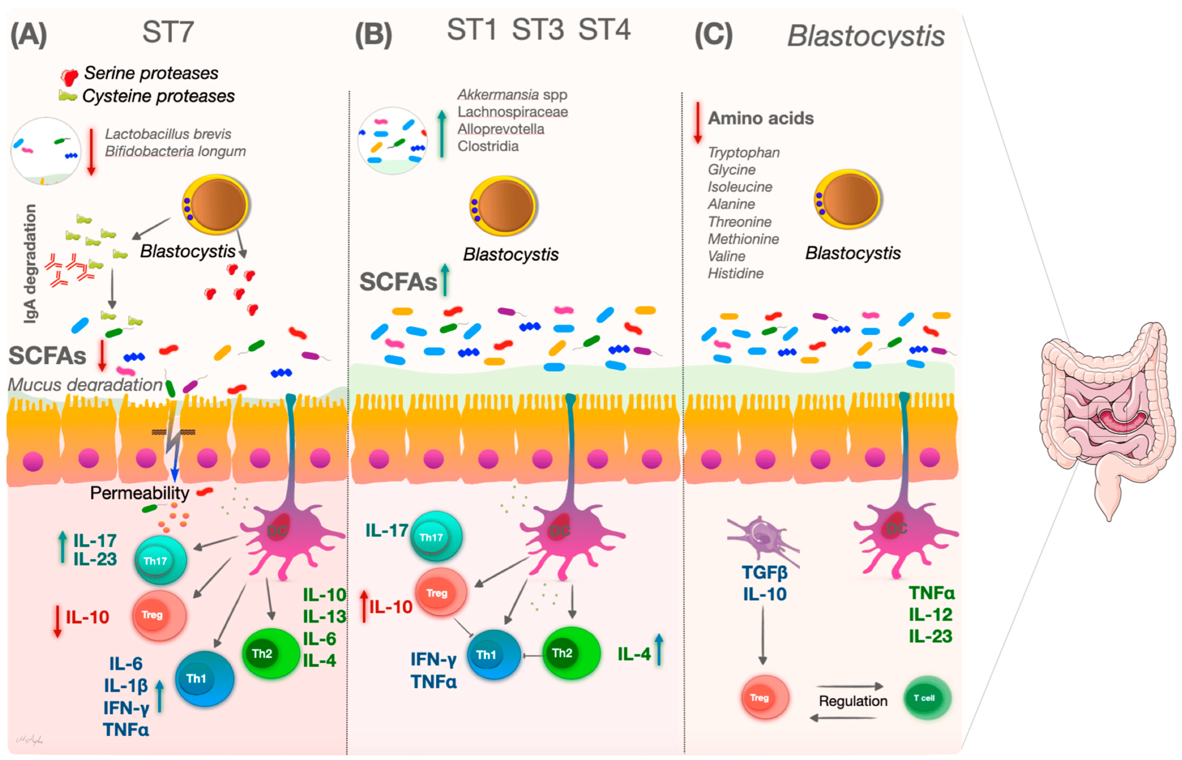
Maybe apply a differentiated view for now
Aykur M, Malatyalı E, Demirel F, Cömert-Koçak B, Gentekaki E, Tsaousis AD, Dogruman-Al F. Blastocystis: A Mysterious Member of the Gut Microbiome. Microorganisms. 2024; 12(3):461.
Pro-inflammatory environment
Anti-inflammatory environment

Slide 21
DNA detection and sequencing methods
Conventional PCR + Sanger seq
Nested PCR
Real-time PCR
Metabarcoding – ILLUMINA, Nanopore, PacBio
Metagenomics – shotgut seq
WGS

Slide 22
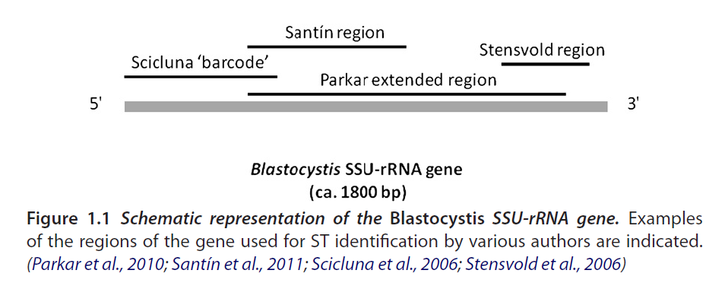
DNA detection and sequencing methods
Conventional PCR + Sanger seq
Typically PCR of a 500-600 bp region with subsequent Sanger seq of the small subunit (SSU) ribosomal RNA (rRNA) gene, in the understanding that these genes are potent taxonomic markers

Slide 23
DNA detection and sequencing methods
Nested PCR + Sanger seq
Typically PCR of the whole SSU rRNA gene followed by a 500-600 bp region within the gene to give extra sensitivity (and maybe also specificity).
RD5
RD3

Slide 24
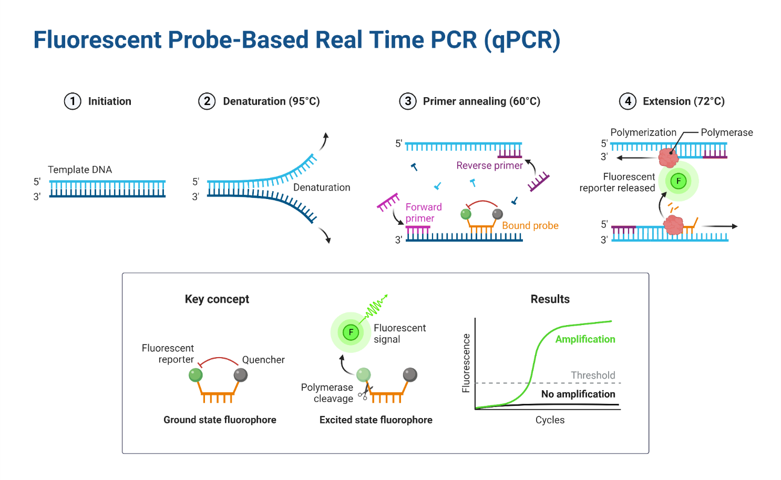
DNA detection and sequencing methods
Conventional PCR + Sanger seq – including barcoding
Real-time PCR

Slide 25
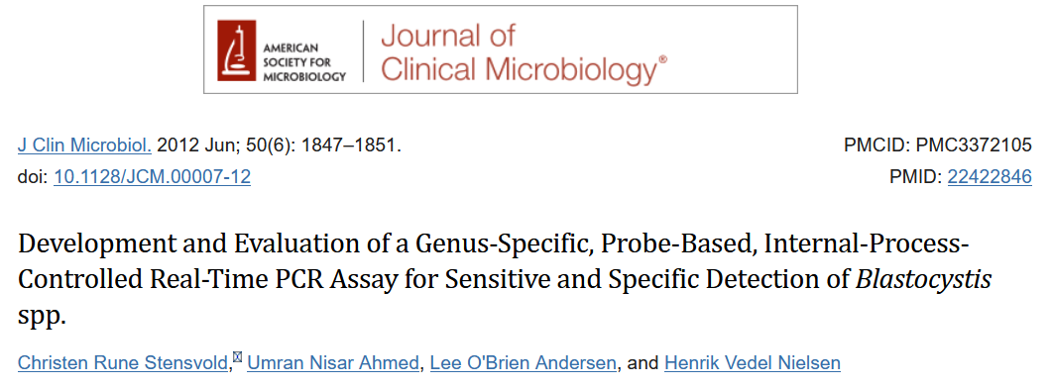
DNA detection and sequencing methods
Conventional PCR + Sanger seq – including barcoding
Real-time PCR

Slide 26
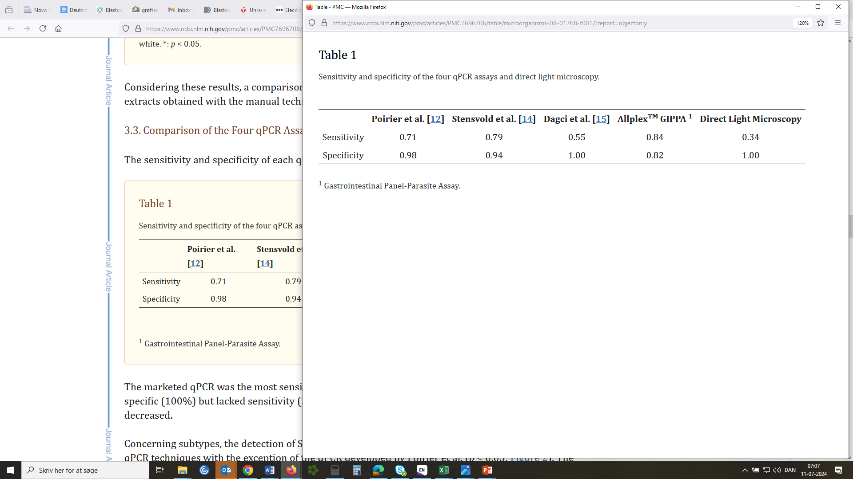
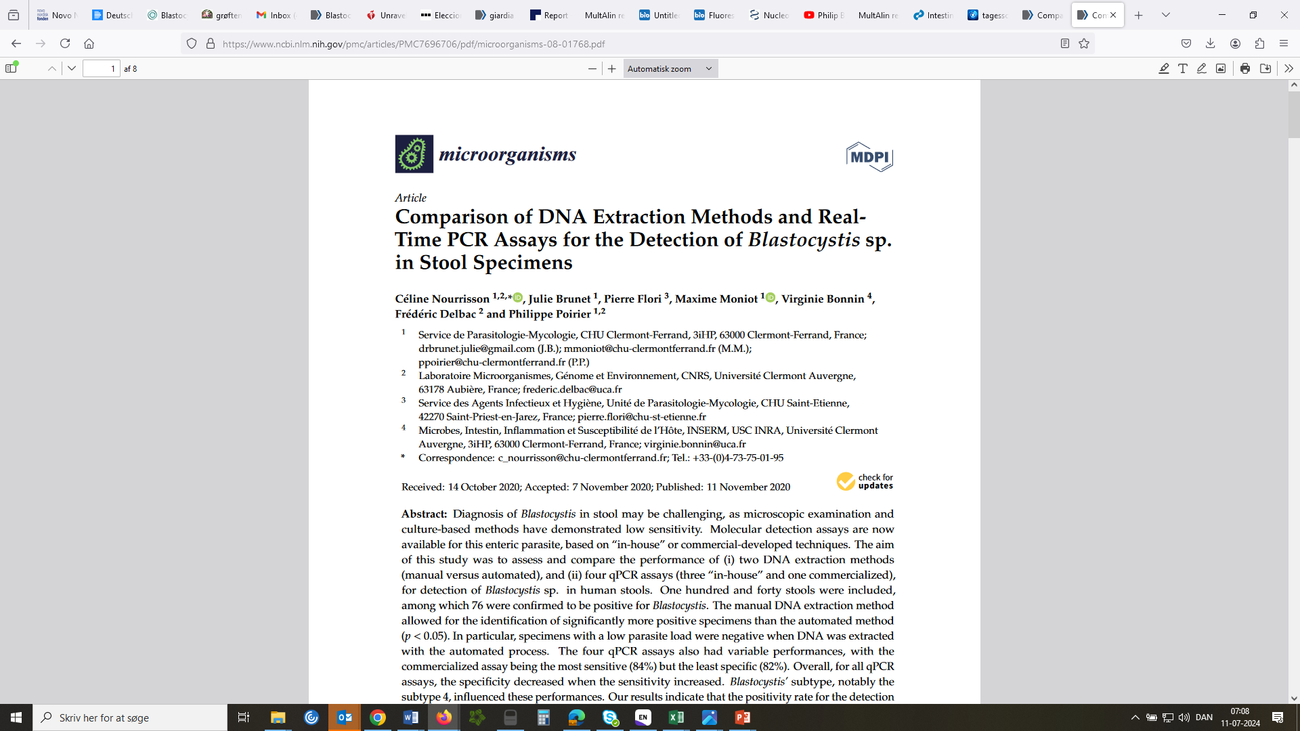
DNA detection and sequencing methods
Conventional PCR + Sanger seq – including barcoding
Real-time PCR
Notes:
A bit of sensitivity is lost since we have the internal process control

Slide 27
DNA detection and sequencing methods
Conventional PCR + Sanger seq – including barcoding
Real-time PCR
Metabarcoding – ILLUMINA, Nanopore, PacBio

Slide 28
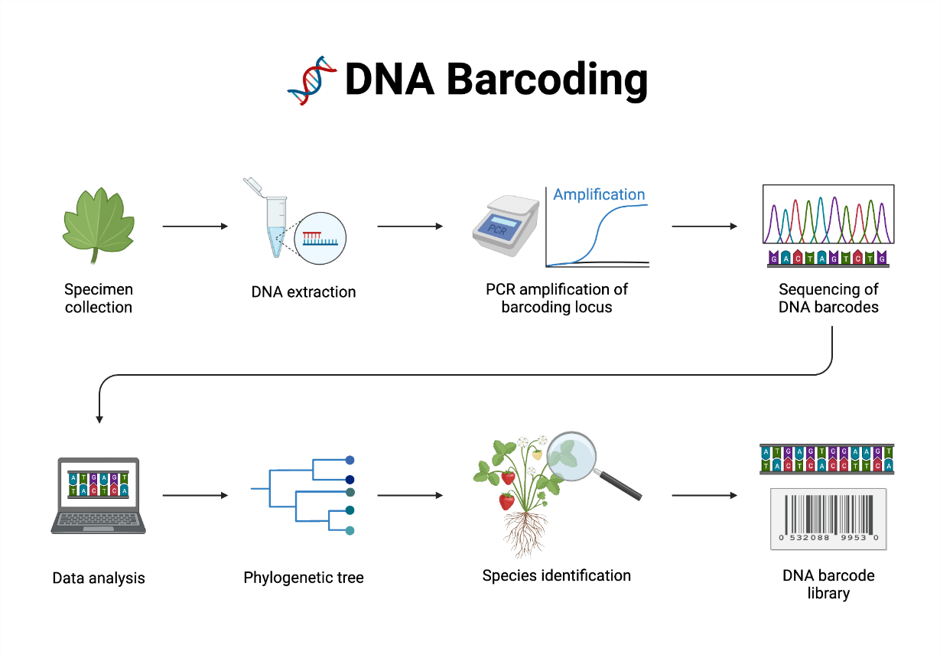
DNA detection and sequencing methods
Conventional PCR + Sanger seq – including barcoding
Real-time PCR
Metabarcoding – ILLUMINA, Nanopore, PacBio

Slide 29
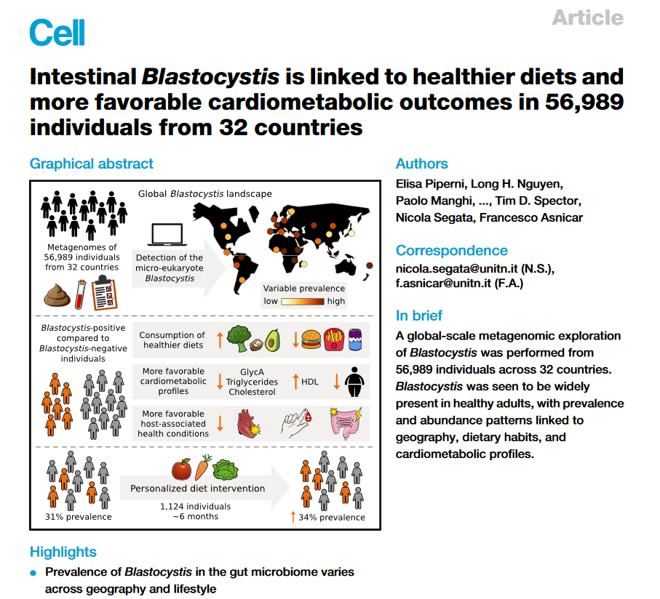
DNA detection and sequencing methods
Conventional PCR + Sanger seq
Real-time PCR
Metabarcoding
Metagenomics – shotgut seq

Slide 30
DNA detection and sequencing methods
Conventional PCR + Sanger seq
Real-time PCR
Metabarcoding – ILLUMINA, Nanopore, PacBio
Metagenomics – shotgut seq
WGS

Slide 31
Points of address
False-negative results
False-positive results
Defining positive/negative samples using NGS methods
Overlooking mixed infections
Erroneous conclusions

Slide 32
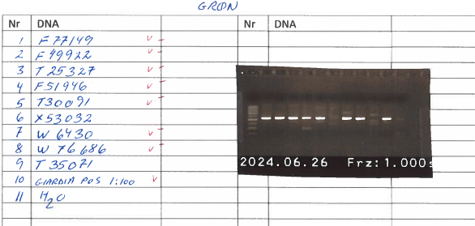
False-positive and false-negative results
False-negative results (no PCR products)
Inhibition control
Dilute template 1:10 and re-do PCR
Amplify an organism that should be there (bacterium) or host DNA
False-positive results (relying on presence of bands only)
Sequence PCR products and check sequences carefully

Slide 33
Points of address
False-negative results
False-positive results
Defining positive/negative samples using NGS methods – using metabarcoding as an example

Slide 34
Metabarcoding – amplicon-based NGS
Metabardocing @SSI
1 pair of 16S primers (modified version of prokaryotic primer 341F/806R)
3 pairs of 18S primers (G3F1/G3R1 [V3-V4], G4F1/G4R1 [V3-V5], and G6F1/G6R1 [V3-V4])
PCR1 – regular PCR
PCR2 – attachement of adaptors and index keys
Quantification of DNA to prepare equimolar amounts of each sample, resulting in a pooling amplicon library (PAL)
Agencourt AMPure XP Bead Kit (Beckman Coulter, Brea, CA, USA) is used to remove amplicons of undesirable length (keeping only fragments between 300 bp and 1000 bp) → purified amplicon library
Sequencing using Illumina MiSeq desktop sequencer

Slide 35
Metabarcoding
MiSeq data is processed using the BION metagenomic pipeline (including checking for chimeras) and mapped to the Ribosomal DNA Project (RDP), SILVA reference databases + an in-house parasite-specific database for taxonomic assignment
You can quality control the findings by extracting and aligning fasta files, generate consensus sequences and query these in the NCBI Database

Slide 36
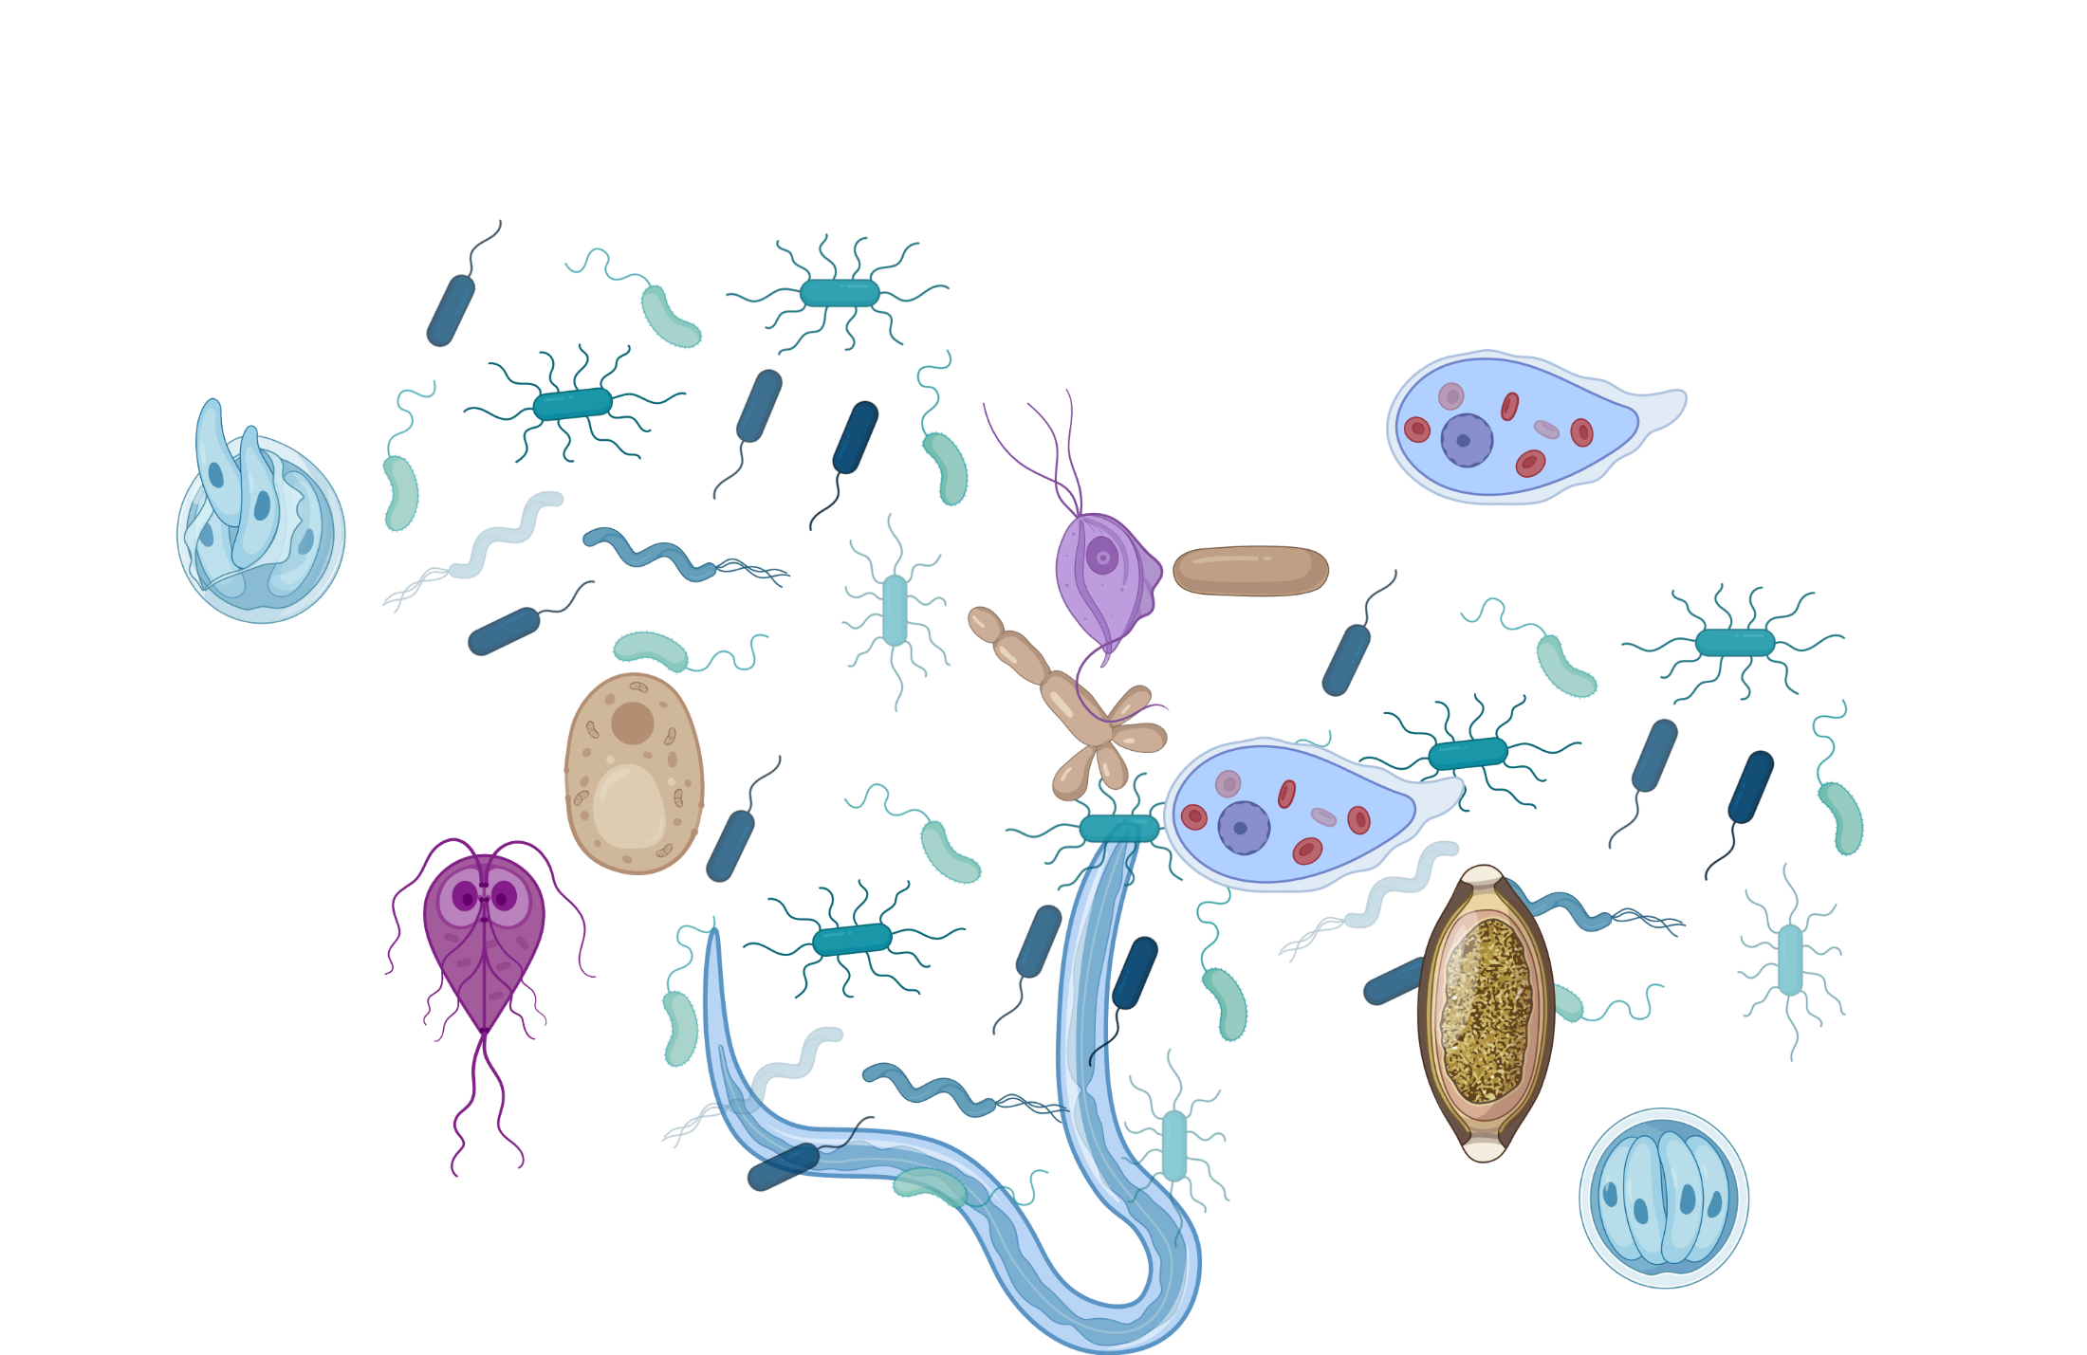
Advantages of metabardocing (leverage)
Theoretically, you can detect all parasites, fungi and bacteria in the gut

Slide 37
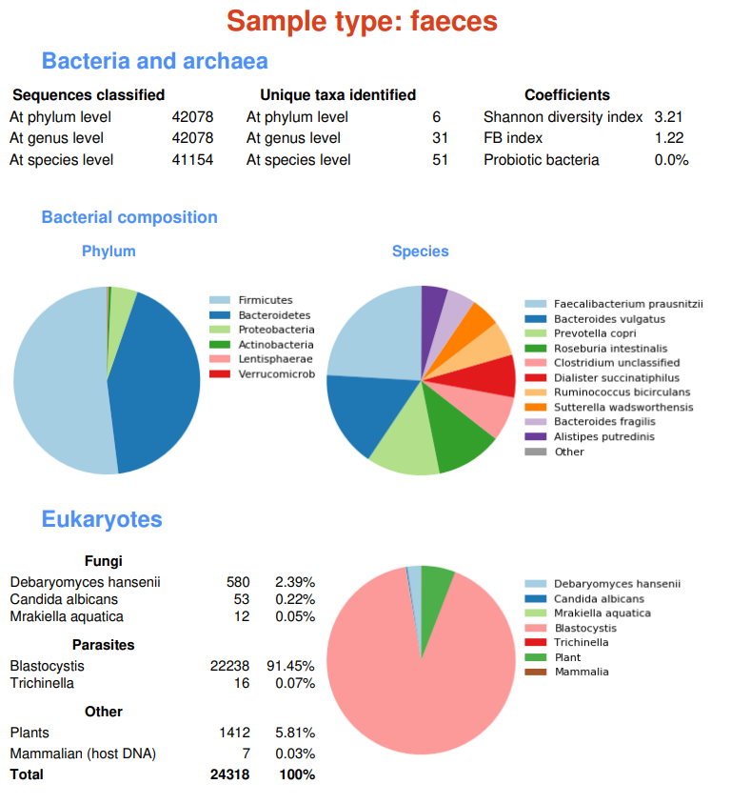

Slide 38
Advantages of metabardocing (leverage)
Screen for genetic diversity within Blastocystis and other organisms of interest
Detect mixed subtype infections
Analyse Blastocystis in a microbiome context

Slide 39





Advantages of metabardocing (leverage)
PP073382 – I17-BPS048(e) – Fallow deer – Algeria
Screen for genetic diversity – here:
Intrageneric diversity of Iodamoeba
100
PP073409 – I5-BPS048(b) – Goat – Algeria
PP073403 – I6-BPS048(h) – Goat – Algeria
PP073381 – I17-BPS048(d) – Fallow deer - Algeria
PP073401 – I6-BPS048(f) – Goat – Algeria
PP073395 – I18-BPS048(j) – Fallow deer – Algeria
PP073399 – I6-BPS048(d) – Goat – Algeria
PP073400 – I6-BPS048(e) - Goat – Algeria
PP073415 – B33-BPS045(d) – Dromedary – Algeria
99
PP073385 – I17-BPS048(h) – Fallow deer – Algeria
RL2c
97
PP073402 – I6-BPS048(g) – Goat – Algeria
PP073389 – I18-BPS048(d) – Fallow deer – Algeria
98
PP073416 – B33-BPS045(e) – Dromedary – Algeria
80
PP073384 – I17-BPS048(g) – Fallow deer – Algeria
PP073386 – I18-BPS048(a) – Fallow deer – Algeria
PP073387 – I18-BPS048(b) – Fallow deer – Algeria
PP073388 – I18-BPS048(c) – Fallow deer – Algeria
89
PP073383 – I17-BPS048(f) – Fallow deer – Algeria
PP073394 – I18-BPS048(i) – Fallow deer – Algeria
99
PP073378 – I17-BPS048(a) – Fallow deer – Algeria
91
PP073393 – I18-BPS048(h) – Fallow deer – Algeria
PP073380 – I17-BPS048(c) – Fallow deer – Algeria
92
PP073392 – I18-BPS048(g) – Fallow deer – Algeria
100
PP073410 – B34-BPS045(a) – Dromedary - Algeria
RL2b
90
PP073412 – B33-BPS045(a) – Dromedary – Algeria
PP073390 – I18-BPS048(e) – Fallow deer – Algeria
98
PP073398 – I6-BPS048(c) – Goat – Algeria
PP073408 – I5-BPS048(a) – Goat – Algeria
PP073397 – I6-BPS048(b) – Goat – Algeria
PP073379 – I17-BPS048(b) – Fallow deer – Algeria
95
PP073411 – B34-BPS045(b) – Dromedary – Algeria
PP073414 – B33-BPS045(c) – Dromedary - Algeria
PP073391 – I18-BPS048(f) – Fallow deer – Algeria
90
PP073413 – B33-BPS045(b) – Dromedary – Algeria
91
PP073396 – I6-BPS048(a) – Goat – Algeria
JN635744 – Pig – United Kingdom
93
PP073417 – B14-BPS044 – Goat – Algeria
RL2a
PP073404 – B26-BPS045 – Dromedary – Algeria
MK801432 – Pig – Germany
96
MK801454 – Pig – Germany
86
MK801438 – Pig – Germany
MK801463 – Pig – Germany
JN635740 – Human – Cuba
RL1b
MK801464 – Pig – Germany
100
JN635742 – Human – unknown origin
JN635746 – Human – Thailand
PP073419 – 1-BPS005(a) – Human – Madagascar
100
PP073427 – 40-BPS007(d) – Human – Western Sahara
PP073422 – 66-BPS007(b) – Human – Ecuador
99
PP073405 – 79-BPS011(a) – Human – Ecuador
PP073425 – 40-BPS007(b) – Human – Western Sahara
RL1a
98
PP073426 – 40-BPS007(c) – Human – Western Sahara
90
PP073407 – 79-BPS011(c) – Human – Ecuador
Guilane et al., in review
84
95
PP073429 – 32-BPS007(b) – Human - Madagascar
PP073421 – 66-BPS007(a) – Human – Ecuador
PP073406 – 79-BPS011(b) – Human – Ecuador
92
99
JN635745 – Human – Thailand
PP073420 – 1-BPS005(b) –Human – Madagascar
81
JN635741 – Human – unknown origin
97
PP073428 – 32-BPS007(a) – Human – Madagascar
PP073423 – 66-BPS007(c) – Human – Ecuador
PP073424 – 40-BPS007(a) – Human – Western Sahara
AF149916 – Endolimax nana
0,05

Slide 40
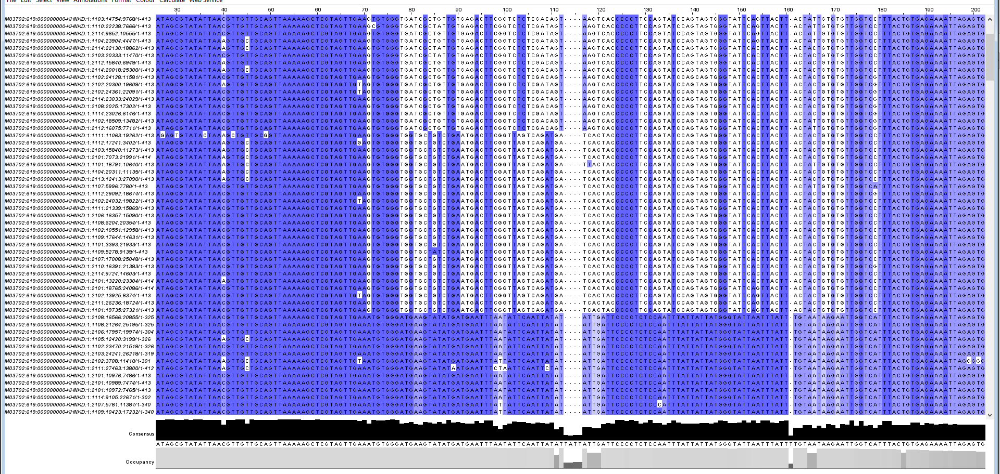
Advantages of metabardocing (leverage)
You can detect mixed Blastocystis infection/colonisation
ST1
ST1
ST5

Slide 41
Mixed Blastocystis ST in pigs

Slide 42
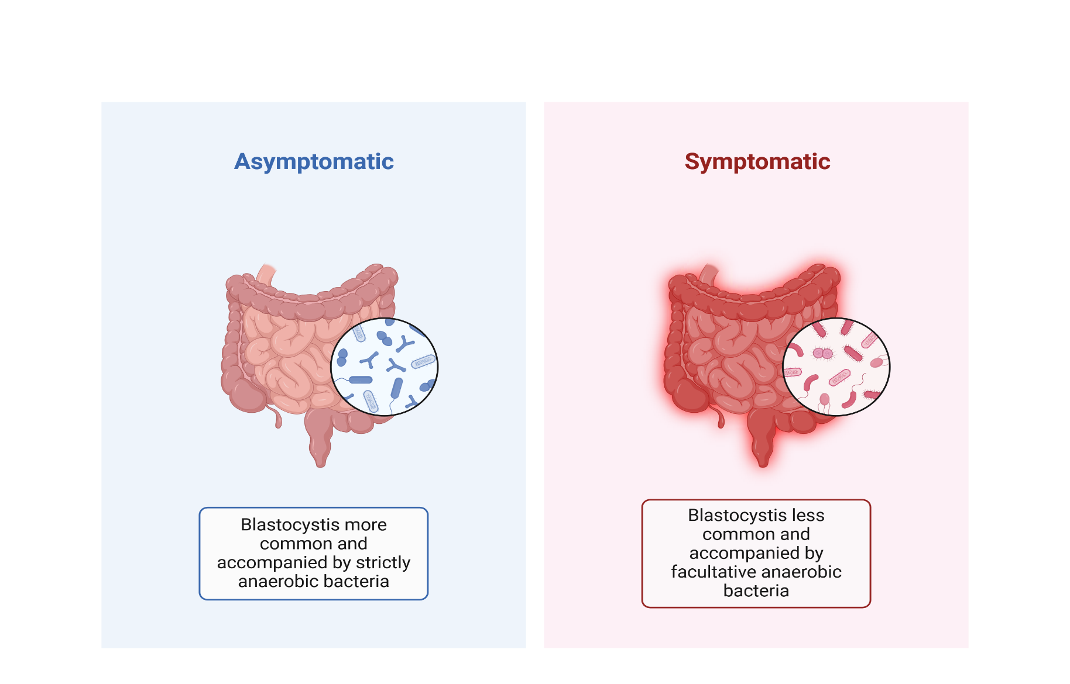
Advantages of metabardocing (leverage)
Your data can be used for diversity analyses if you want to identify the differences in the gut microbiomes between Blastocystis carriers and non carriers

Slide 43
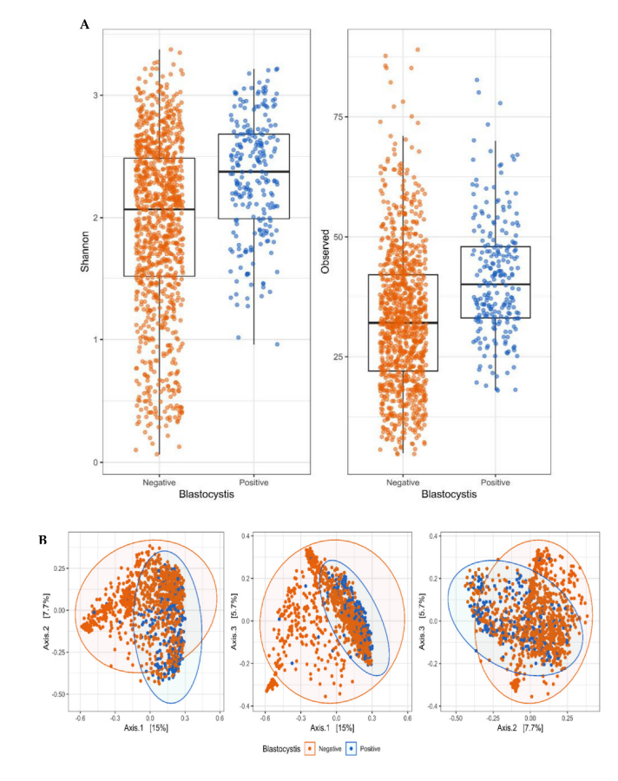
Stensvold et al., 2022 (Microorganisms)
Stool Microbiota Diversity Analysis of Blastocystis-Positive and Blastocystis-Negative Individuals
Differences in Shannon’s diversity index (left) and observed richness (right) between Blastocystis-positive and Blastocystis-negative fecal DNA samples. Both measures differed significantly between the two types of samples (p < 0.0001).

Slide 44
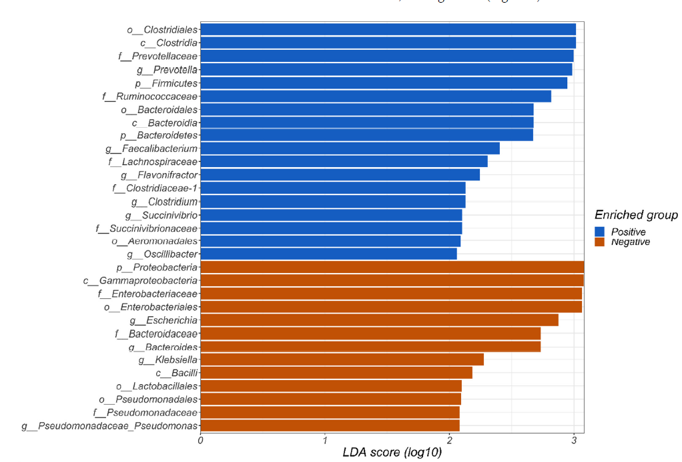
LEFSE ANALYSIS
Is Blastocystis really a marker of a healthy gut? Is it even a ”probiotic”?

Slide 45
Defining positive/negative samples using NGS methods
Problem:
Some samples have 200,000 Blastocystis reads, some 20,000, some 2,000, some 20, and some 2.
Where to put the cut-off? Which ones are positive and which are negative? Can we use absolute numbers or should we look at proportions (i.e., proportion of Blastocystis-specific reads compared with total number of sequence reads for each individual sample?) → rarefaction (a way of normalizing data and controlling for uneven sequencing)
I.e., if you have a sample with 500,000 reads, then you can decide that at least 0.1% of the reads (500) should be Blastocystis in order to deem the sample positive. But you can qualify this by comparing with Ct values from real-time PCR and culture results as well.
Notes:
Enhancing diversity analysis by repeatedly rarefying next generation sequencing data describing microbial communities
Ellen S. Cameron,
Philip J. Schmidt,
Benjamin J.-M. Tremblay,
Monica B. Emelko &
Kirsten M. Müller
Scientific Reports volume 11, Article number: 22302 (2021) Cite this article

Slide 46
Misannotation of DNA sequences can happen through various mechanisms
Less then ~97% similarity to reference sequence
Lack of relevant reference material (NCBI BLAST query may only say, e.g., 95% similarity to ST9 despite full coverage, and then the sequences is annotated erroneously as ST9) → new subtype?
Bad sequence quality (lots of background for example that plays up with the sequence read)
Other technical issues – sequence chimeras for example
Second-generation mis-identification

Slide 47
Example of a problem that we stumbled upon recently
Going over subtypes found in birds, we noticed that ST9 had been reported a lot in peafowl in South East Asia. It said in the article that ”ST9 was the predominant subtype, accounting for 82% (41/50).”
However, it was not ST9 that the authors had found…
Liu X, Zhang S, Dong H, Wang R, Zhang L, Ge Y. PREVALENCE AND MOLECULAR CHARACTERISTICS OF BLASTOCYSTIS SP. FROM PEAFOWL (PAVO CRISTATUS) IN CHINA.
J Parasitol. 2021 Sep 1;107(5):790-793.

Slide 48
ST6
ST9
ST27
ST45
ST7

Slide 49
ST6
ST9
ST27
ST45
ST7

Slide 50
All of these were referred to as either ST6 or ST9 in NCBI Database or in publications. Most were published before MW887934, however, which is the reference sequence for ST27.

Slide 51
Example of the ‘danger’ of elevating non-complete sequences to full subtype status: ST27
Example: ST27 – published by the Santin team in 2020, but the full sequence was published only in 2022 (already available in 2021 in NCBI). This means that people working with the barcoding region did not have any ST27 to align to when doing their analyses, and then they ended up instead with something somewhat similar to ST6/ST9

Slide 52
Example of the ‘danger’ of elevating non-complete sequences to full subtype status: ST27
Example: ST27 – published by the Santin team in 2020, but the full sequence was published only in 2022 (already available in 2021 in NCBI). This means that people working with the barcoding region did not have any ST27 to align to when doing their analyses, and then they ended up instead with something somewhat similar to ST6/ST9
Coverage is key!!

Slide 53
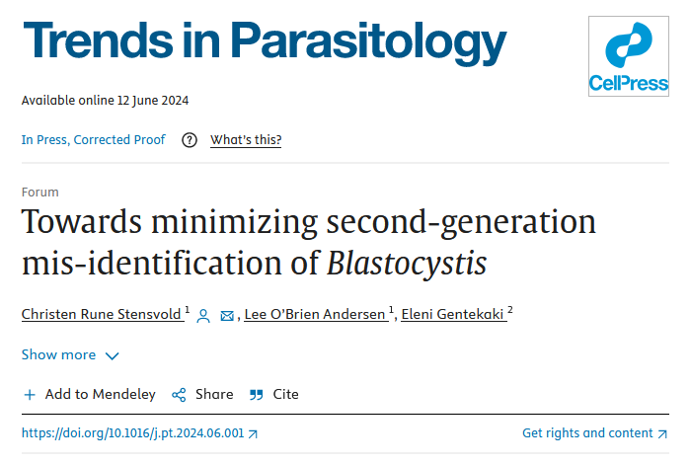
Towards minimizing second-generation mis-identification of Blastocystis
”At least 1-2% of DNA sequences annotated as Blastocystis in GenBank represent organisms other than Blastocystis or sequence artefacts. As well as being biologically incorrect, such practice can lead to overestimates of genetic diversity, underestimated host specificity, and incorrect classification of samples tested for Blastocystis using DNA-based methods. “

Slide 54
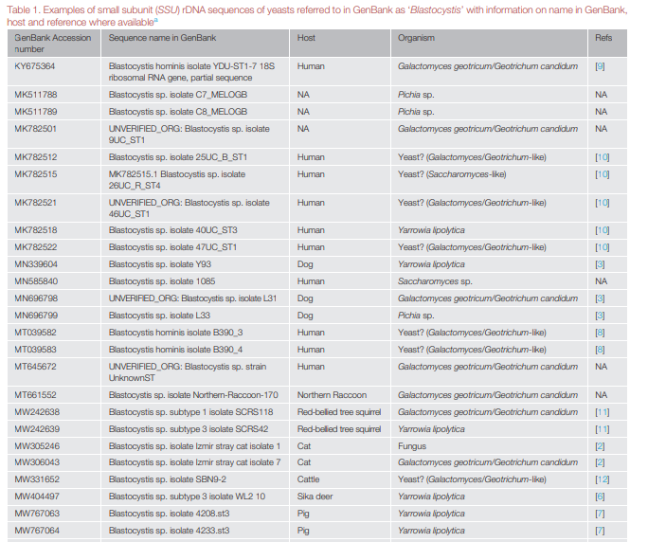
Excerpt from Table 1

Slide 55
Three random examples of second-generation mis-identification
15,000 SSU rDNA sequences of Blastocytis in GenBank
We used the clustering tool ‘cdhit-est’ with the following options: cdhit-est -g 1 -d0 -c 0.85 (http://cd-hit.org) to identify SSU rDNA sequences deposited in GenBank as Blastocystis that were so genetically divergent that they might not be Blastocystis
Apart from fruits and other plants, microorganisms have also been mistakenly named ‘Blastocystis’. At least 67 sequences from yeasts such as Yarrowia, Geotrichum, Galactomyces, or Saccharomyces have been deposited as Blastocystis
At least 200 DNA sequences referred to as Blastocystis SSU rDNA sequences in GenBank, and included in at least 40 published articles, are in one way or another problematic for at least one of various reasons.

Slide 56
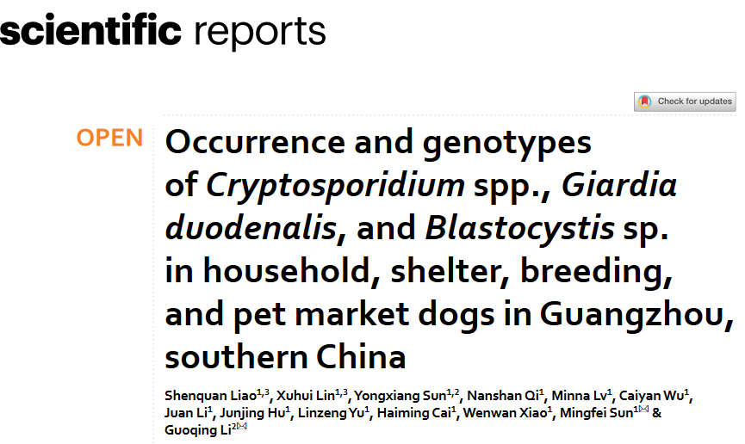
Liao et al., 2020:
”A total of 651 canine stool samples from household (n = 199), shelter (n = 149), breeding (n = 237), and pet market dogs (n = 66) were collected from eight districts in Guangzhou. Blastocystis sp. were found in 21 (3.2%), 20 (3.1%), and 35 (5.4%) samples, respectively.”

Slide 57
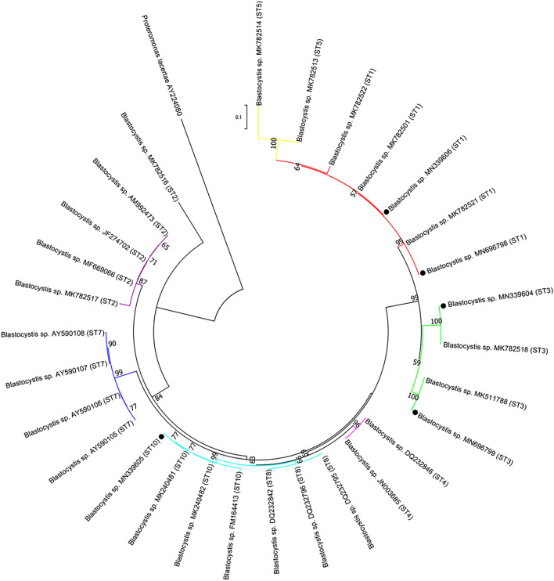
Liao S, Lin X, Sun Y, Qi N, Lv M, Wu C, Li J, Hu J, Yu L, Cai H, Xiao W, Sun M, Li G. Occurrence and genotypes of Cryptosporidium spp., Giardia duodenalis, and Blastocystis sp. in household, shelter, breeding, and pet market dogs in Guangzhou, southern China. Sci Rep. 2020 Oct 20;10(1):17736. doi: 10.1038/s41598-020-74299-z. PMID: 33082394; PMCID: PMC7576217.
Scientific Reports is a peer-reviewed open-access scientific mega journal published by Nature Portfolio, covering all areas of the natural sciences. The journal was established in 2011.

Slide 58
”Twenty-seven nucleotide sequences identified as ST3 were identical to each other and had 100% similarity to the MK782518 reference sequence from urticaria patients in Brazil”
SO much is wrong here. No ST3 sequences were included in the tree. First notion about something fishy is by looking at where “ST3” goes in the figure – usually it goes with ST4 and ST8. Moreover the two reference sequences – MK782518 and MK511788 are not Blastocystis at all, but were deposited in GenBank as such, making way for second-generation mis-identification. Indeed MK782518 and MK511788 are Yarrowia lipolytica and Pichia sp., respectively.

Slide 59
The red oval ring covers reference sequences that were all yeasts.
This means that out of
the 35 so-called Blastocystis sequences, only one was Blastocystis, and that sequence was a ST10 sequence. ST10 is
usually seen in larger herbivorous animals,
and could be an incidental finding that could reflect the coprophagous habits of
dogs.

Slide 60
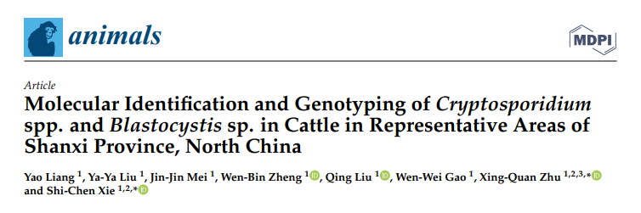
“The present study collected 795 fecal samples from cattle in Shanxi Province and these fecal samples were examined for presence of Cryptosporidium spp. and Blastocystis sp. using molecular methods. The prevalence of Cryptosporidium spp. in cattle in Shanxi Province was 2.9% (23/795), and all of the positive samples were identified as C. andersoni. The prevalence of Blastocystis sp. in cattle in Shanxi Province was 13.0% (103/795), including five known subtypes (ST1, ST10, ST14, ST21 and ST26) and three unknown subtypes.”

Slide 61
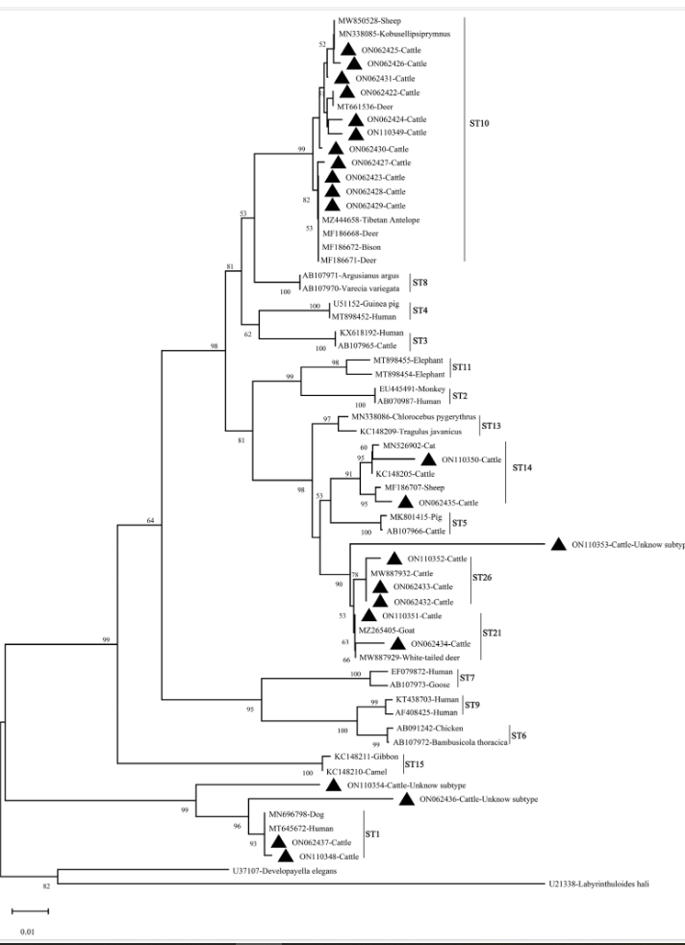
Yeast sequences indicated as ‘ST1’.

Slide 62
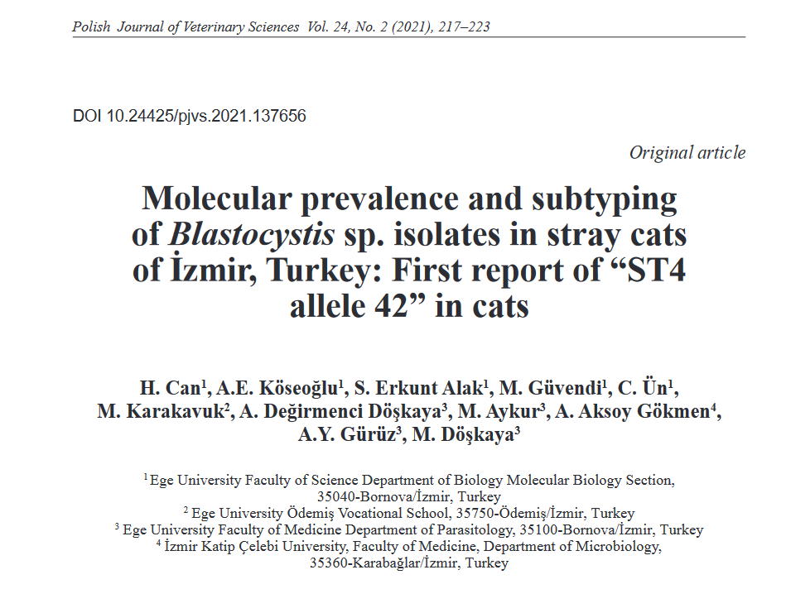
A total of 465 fecal samples were collected from veterinary clinics located in 5 different districts
Barcoding primers were used (Scicluna, 2006)
17 (17/465; 3.65%) samples were found to be Blastocystis-positive.

Slide 63
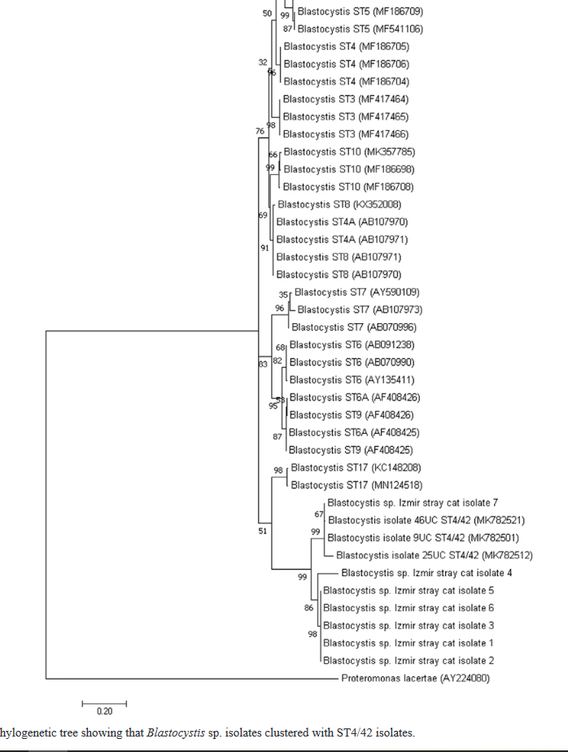
Polish Journal of Veterinary Sciences
Molecular prevalence and subtyping of Blastocystis sp. isolates in stray cats of İzmir, Turkey: First report of “ST4
allele 42” in cats
Three issues:
AB107970 and AB107971 featuring twice
ST4 is entered twice in the tree (arrows)
References named ‘ST4/42’ are yeast sequences

Slide 64
MK782501, MK782512, MK782521
= Galactomyces geotricum/Geotrichum candidum (yeasts)
→ Example of second-generation mis-identification of Blastocystis

Slide 65
Towards minimizing second-generation mis-identification of Blastocystis
So, these sequences were not Blastocystis sequences but yeast sequences. This is unfortunate for two major reasons:
It gives the impression that Blastocystis is relatively common in cats (which it is not) → underestimated host specificity
The very title and abstract of the article highlights the zoonotic potential of Blastocystis in cats since they claimed to have found ST4 allele 42, which is common in humans in Europe → misleading conclusion

Slide 66
Erroneous conclusions
Dealing with sequence artefacts/misidentification of sequences
Lack of awareness of wrong sequences in GenBank
Lack of BLASTing skills (failure to look carefully at coverage, similarity, e Values)
Forgetting that detected Blastocystis DNA might stem from ingested prey, Blastocystis-contaminated water or coprophagy

Slide 67
Take-home messages with regard to DNA-based detection and differentiation of Blastocystis
Be aware of factors influencing false-positive and false-negative results – and check! (QA)
Use curated databases for DNA sequence queries when information on subtype is needed
If you obtain low similarity when querying sequences against references sequences, scrutinize your sequence and look for elements of
Low-quality sequencing
Double peaks
Chimera formation
If BLAST queries are performed in NCBI nucleotide database, be critical with regard to both sequences and metadata – at least 1–2% of ”Blastocystis” SSU rDNA sequences are not Blastocystis
Sanger sequencing of raw PCR products may only show the more predominant subtype – use NGS if exhaustive subtype information is needed
Remember that PCR + seq cannot differentiate between active colonisation and host ‘contamination’ (accidental host, transport host, parasites from prey)

Slide 68
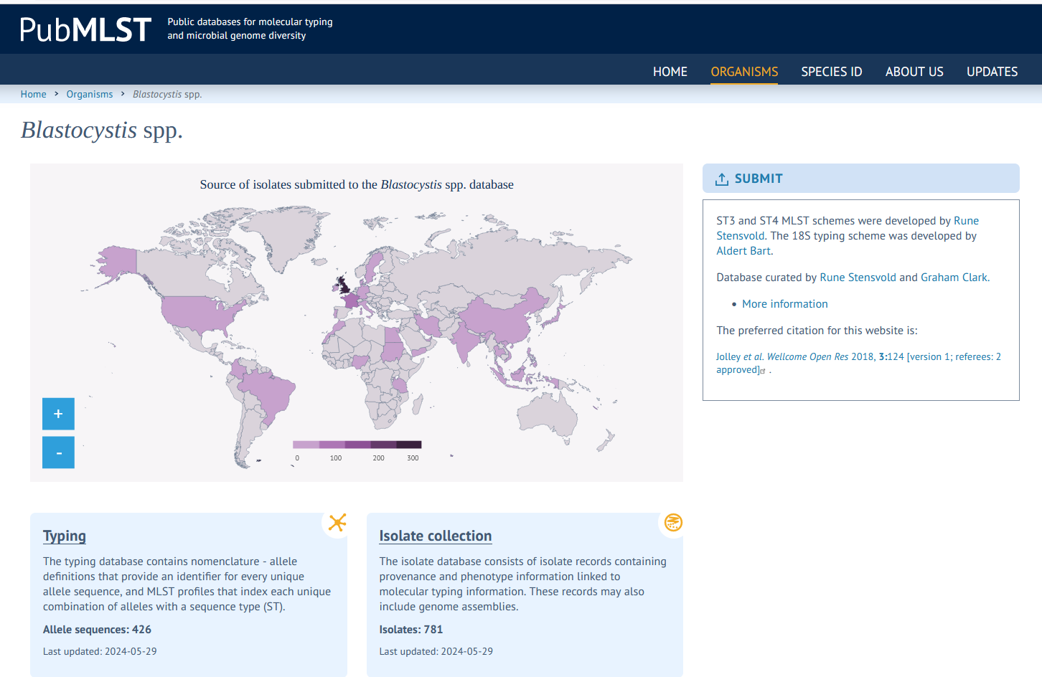
Cuated reference databases for Blastocystis
https://entamoeba.lshtm.ac.uk/refseqs.htm
https://pubmlst.org/organisms/blastocystis-spp

Slide 69
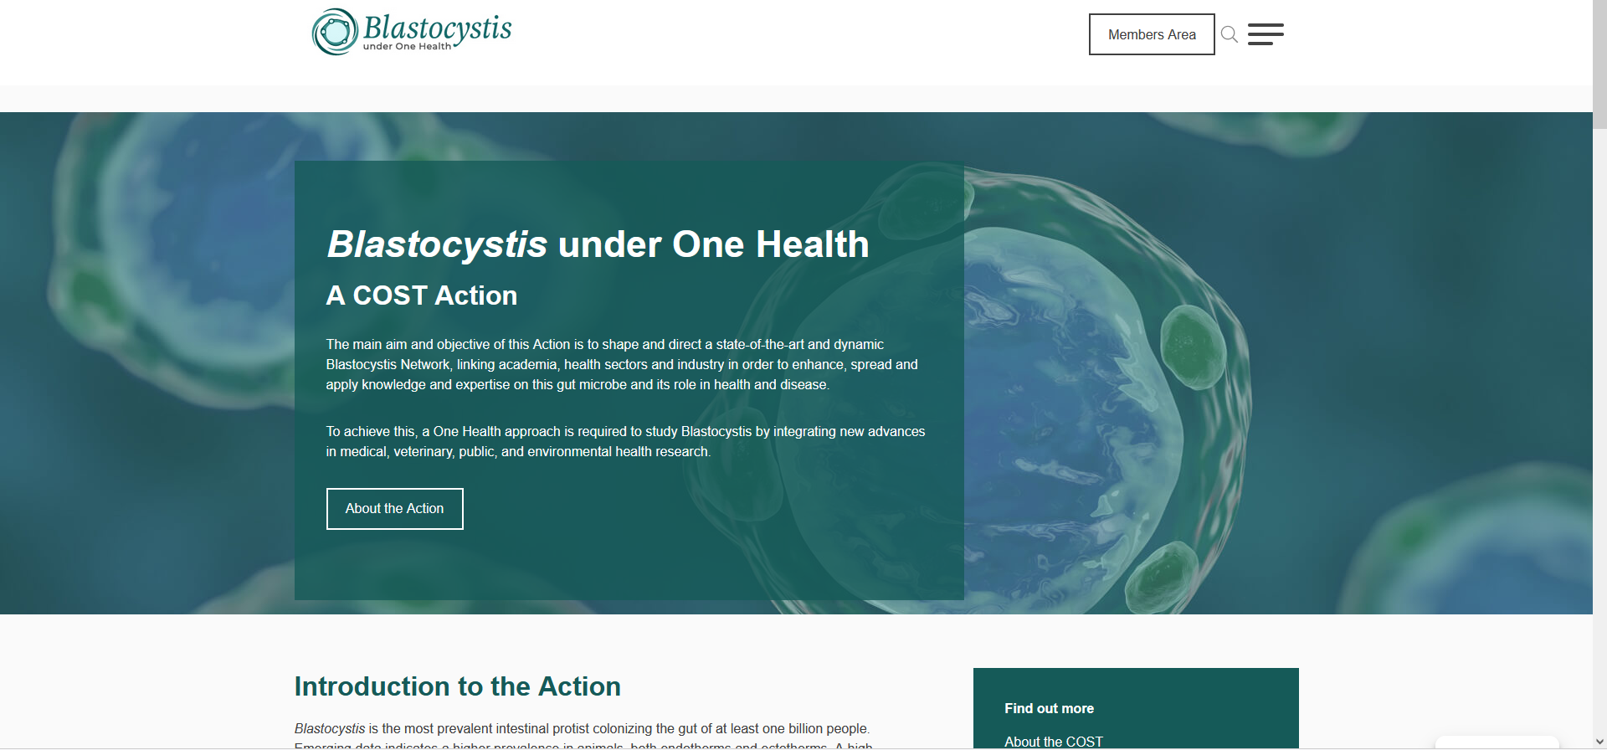
Useful links
https://blastocystis-cost.com/

Slide 70

Useful links
https://blastocystis-cost.com/publications/

Slide 71
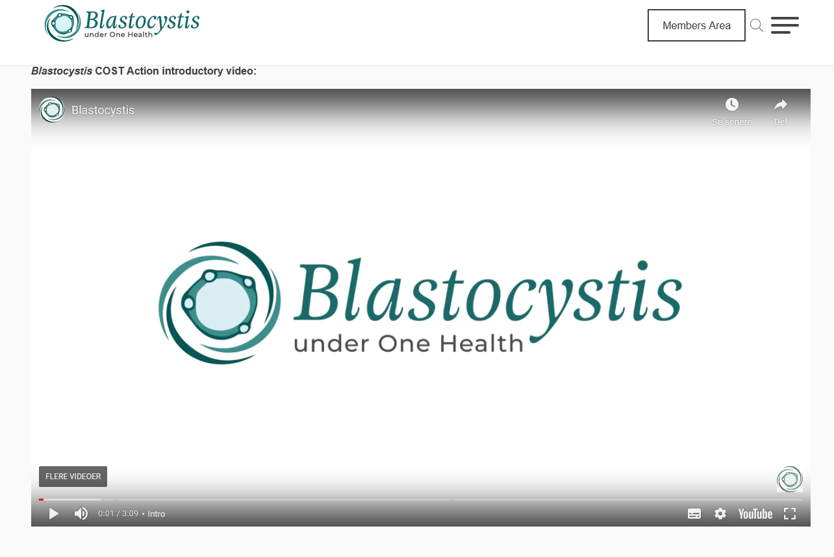
Useful links
https://blastocystis-cost.com/publications/

Slide 72
Be. Very. Careful. In. Times. Of. AI.
https://typeset.io/
“SciSpace is an incredible (AI-powered) tool to help you understand research papers better. It can explain and elaborate most academic texts in simple words.”

Slide 73

SCISPACE…

Slide 74
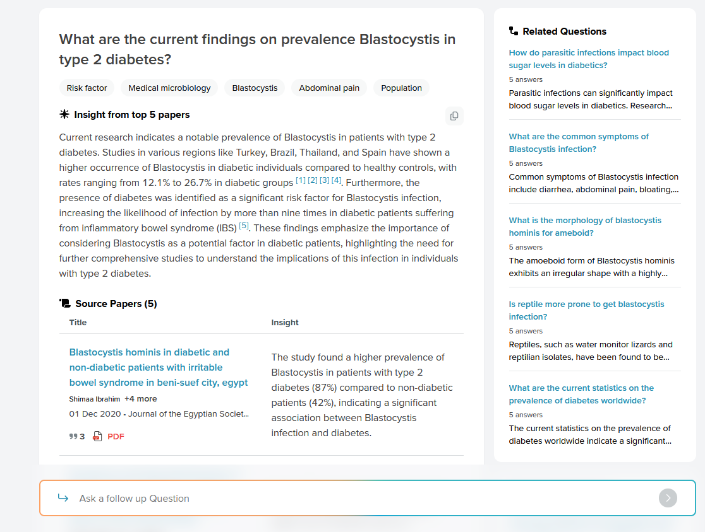
Be critical regarding AI algorithms!

Slide 75
ChatGPT
Useful for (examples)
Calculation of sample sizes
Doing statistical tests (it may even inform you whether your dataset supports a given statistical test)
Definitions of cut-off values for biochemial parameters
Editing text – including checking for spelling
Generating hypotheses – but be careful
But don’t rely on it for metanalyses for instance. Or doing reviews.

Slide 76







Acknowledgements

